Slide 1
ER models
Kazi Amit Hasan

Slide 2
Weak Entities
some entities would not be in the database unless it is related to some other entity that is in the database.
we call the dependent entity a “weak entity”.
weak entity has no primary key but can be uniquely identify by association with another strong entity

Slide 3
Weak Entities
Weak entities do not have any primary key
They cannot be identified on their own, so they depend on some other entity (known as owner entity)
The weak entities have total participation constraints (existence dependency) in its identifying relationship with owner identity
Weak entity types have partial keys. Partial keys are set of attributes, with the help of which the tuples of weak entities can be identified and distinguished.

Slide 4
Weak Entities
Weak entities are represented with double rectangular box in the ER diagram
The identifying relationships are represented with double diamond
Partial key attributes are represented with dotted lines

Slide 5
Amount
E_id
Name
Name
Age
Owner
entity
Identifying
relationship
Has
Employee
Dependent
Dependent
Weak entity
address
Dependent always participate totally. Kate and Sophia would only exist if Employee table has E1
E1 E2 E3
Alex Nick Marcos
Toronto Perth Ottawa
E1 E1 E3
Kate Sophia Kate
25 6 25

Slide 6
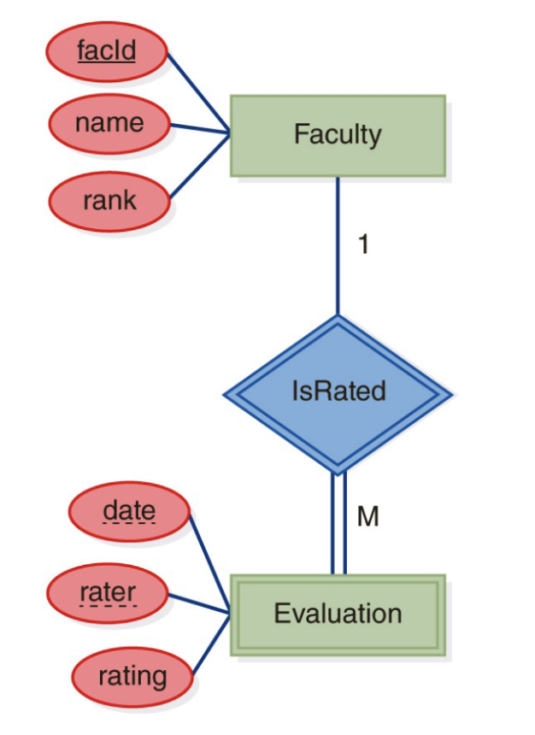
facId | name | rank
F101 | Dr. Smith | Professor
F102 | Dr. Khan | Lecturer
Dr. Smith was evaluated:
On 2025-01-10 by StudentA, rating 4
On 2025-01-10 by StudentB, rating 5
Dr. Khan was evaluated:
On 2025-01-10 by StudentA, rating 3
facId | date | rater | rating
F101 | 2025-01-10 | StudentA | 4
F101 | 2025-01-10 | StudentB | 5
F102 | 2025-01-10 | StudentA | 3
Evaluation table
What will happen if one faculty quits?

Slide 7
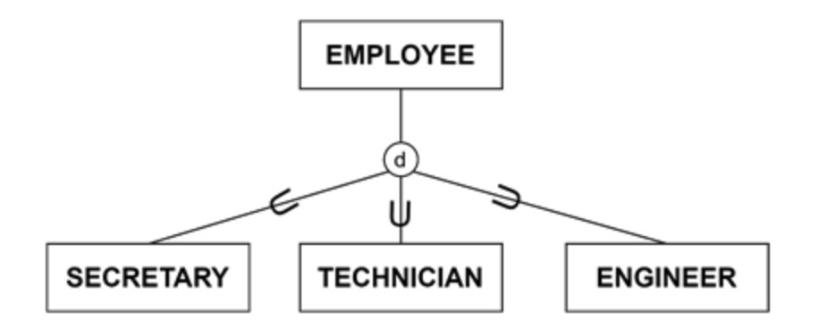
Specialization (extended ER model)
Specialization focuses on dividing a general entity type, or superclass, into smaller, more specific categories called subclasses

Slide 8
Constraints on Specialization
While working on specializations, we face some constraints.
Disjoint:
Entities can belong to only one subclass
an EMPLOYEE cannot simultaneously be a TECHNICIAN and an ENGINEER.
Overlapping:
Entities can belong to multiple subclasses.
a salaried engineer could belong to both SALARIED_EMPLOYEE and ENGINEER.

Slide 9
Constraints on Specialization
Completeness constraint:
Total: Every entity in the superclass must belong to at least one subclass.
For example, all EMPLOYEES are either HOURLY_EMPLOYEES or SALARIED_EMPLOYEES.
Partial: Some entities may not belong to any subclass.
For example, not every EMPLOYEE is a SECRETARY, ENGINEER, or TECHNICIAN.

Slide 10
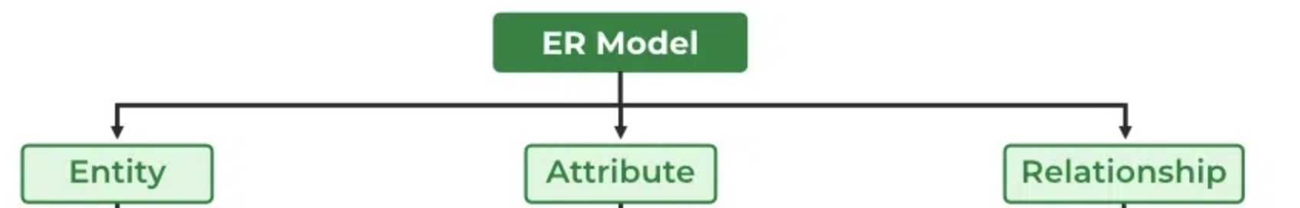
What we have covered so far:

Slide 11
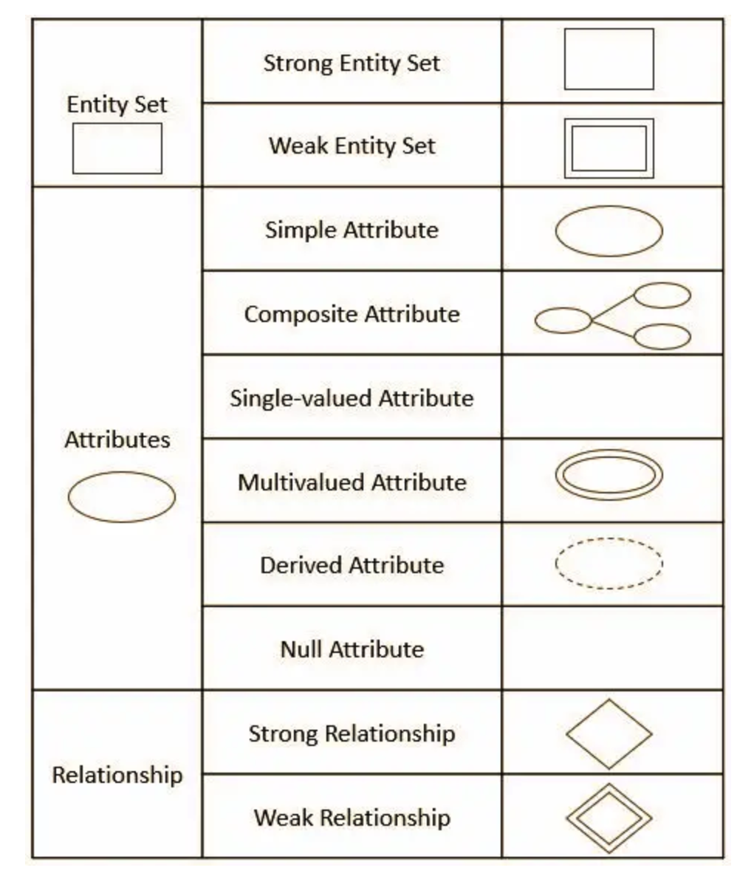
Symbols Used in ER Model
https://tutorials.freshersnow.com/entity-relationship-diagram/

Slide 12
Steps to draw ER diagram
Read the question
Read the question (again)
Read the question(again)
Identify the entity sets
Identify the relevant attributes
Identify the primary keys (and any other keys)
Identify the relationships
Complete the diagram

Slide 13
Question
Suppose you are given the following requirements for a simple database for the National Hockey League (NHL):
the NHL has many teams
each team has a name, a city, a coach, a captain, and a set of players,
each player belongs to only one team,
each player has a name, a position (such as left wing or goalie), a skill level, and a set of injury records,
a team captain is also a player,
a game is played between two teams (referred to as host team and guest_team) and has a date (such as May 11th, 1999) and a score (such as 4 to 2).
Construct a clean and concise ER diagram for the NHL database

Slide 14
Question
Suppose you are given the following requirements for a simple database for the National Hockey League (NHL):
the NHL has many teams
each team has a name, a city, a coach, a captain, and a set of players,
each player belongs to only one team,
each player has a name, a position (such as left wing or goalie), a skill level, and a set of injury records,
a team captain is also a player,
a game is played between two teams (referred to as host team and guest_team) and has a date (such as May 11th, 1999) and a score (such as 4 to 2).
Construct a clean and concise ER diagram for the NHL database

Slide 15
Identify the entity set
TEAM
PLAYER
INJURY_RECORD

Slide 16
Identify the relevant attributes
Team: tname, city, coach
Player: pid, pname, position, skill_level
Injury records: injury_id, description

Slide 17
Identify the primary keys
TEAM: t_name
PLAYER: pid
INJURY_RECORD: {pid,injury_id)

Slide 18
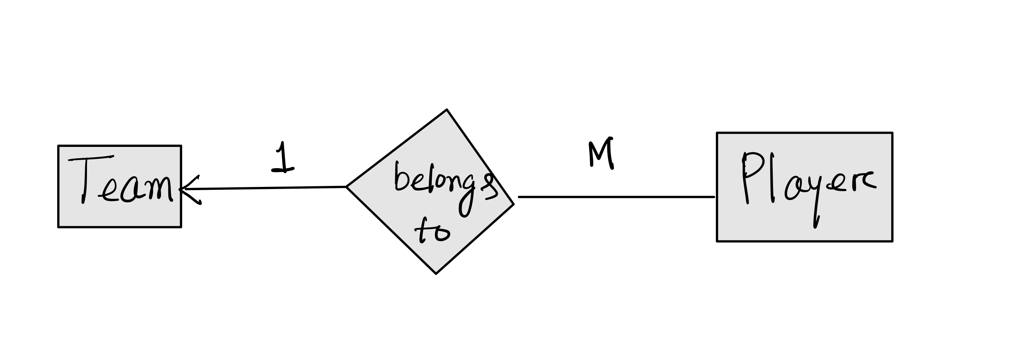
Identify the relationships
each team has a name, a city, a coach, a captain, and a set of players,
each player belongs to only one team

Slide 19
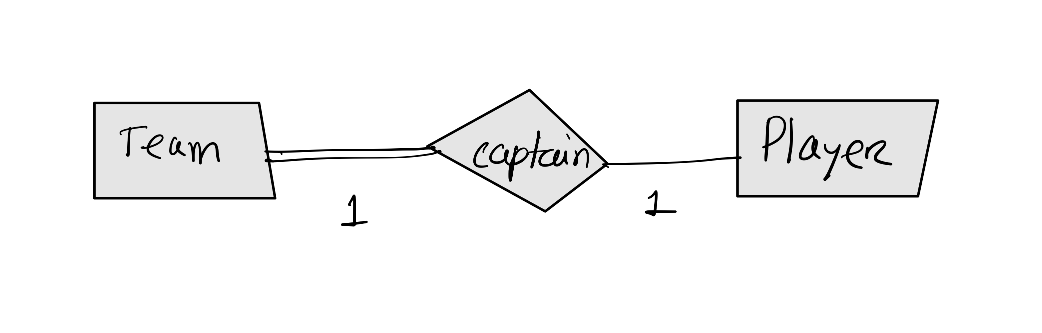
Identify the relationships
each team has a name, a city, a coach, a captain, and a set of players,
a team captain is also a player,

Slide 20
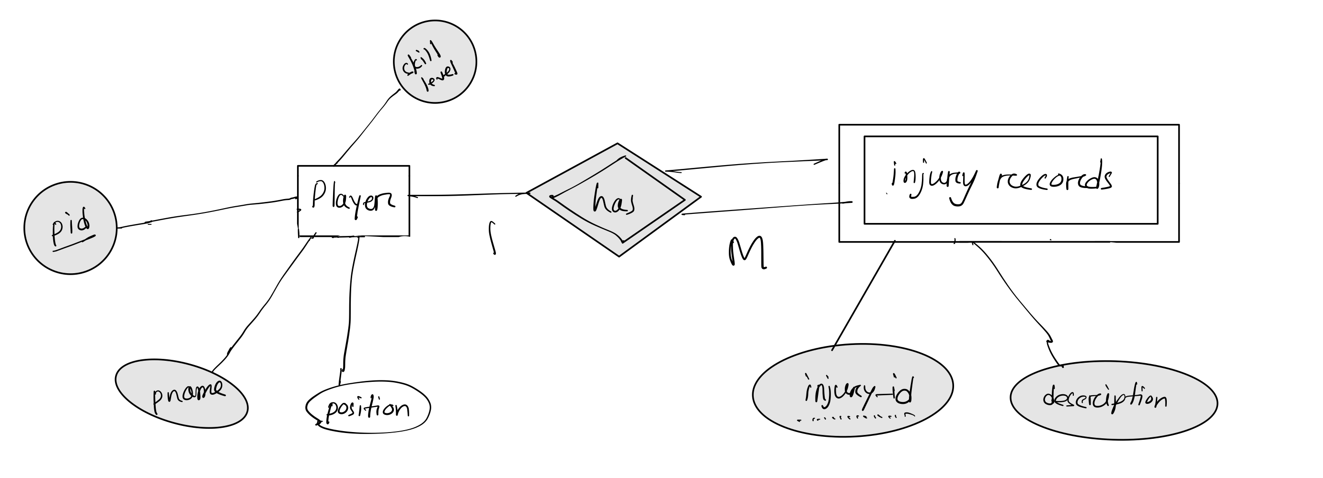
Identify the relationships
each player has a name, a position (such as left wing or goalie), a skill level, and a set of injury records,

Slide 21
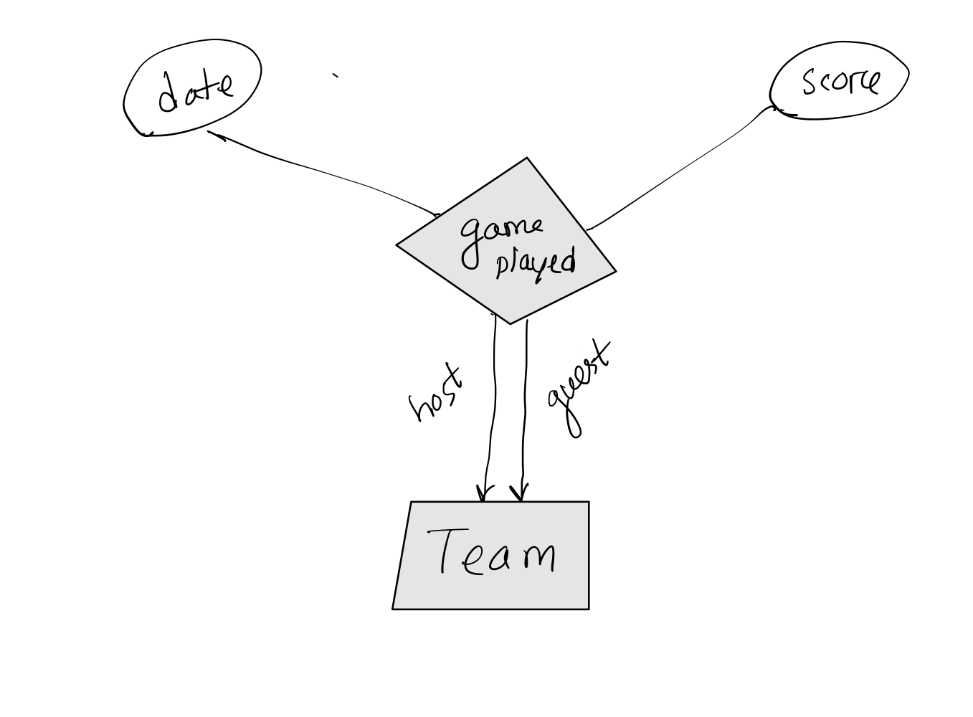
Identify the relationships
a game is played between two teams (referred to as host team and guest_team) and has a date (such as May 11th, 1999) and a score (such as 4 to 2).
Recursive relationship

Slide 22
Connect them

Slide 23
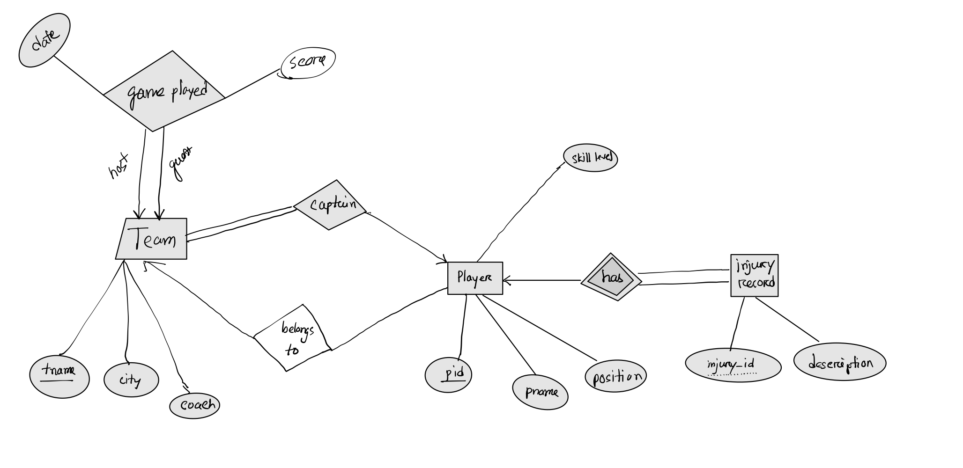
Complete ER diagram

